Slide 1
News Aggregator
Phani Raj 2451-11-737-053
Anudeep 2451-11-737-056
Guided by : A.V.Krishna Prasad

Slide 2
What our site does?
It takes the information from various sources and display them in one place
On an average a person who uses internet to get information or news visits more than 4 times

Slide 3












Slide 4
What is an RSS?
RSS is an XML file.
to publish frequently updated information
e.g. blog entries, news headlines.
RSS feeds enable publishers to syndicate data automatically.
A standard XML file format ensures compatibility with many different machines/programs.

Slide 5
Google Feed API
download any RSS feed using only JavaScript
Free to use

Slide 6
Google Feed API
Google Web Server
XML
JavaScript
HTML
Client

Slide 7
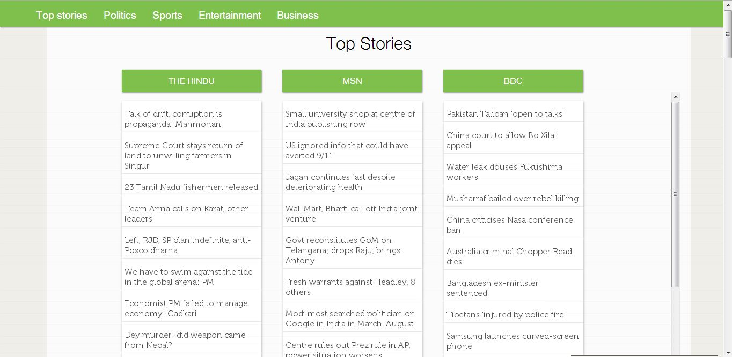

Slide 8
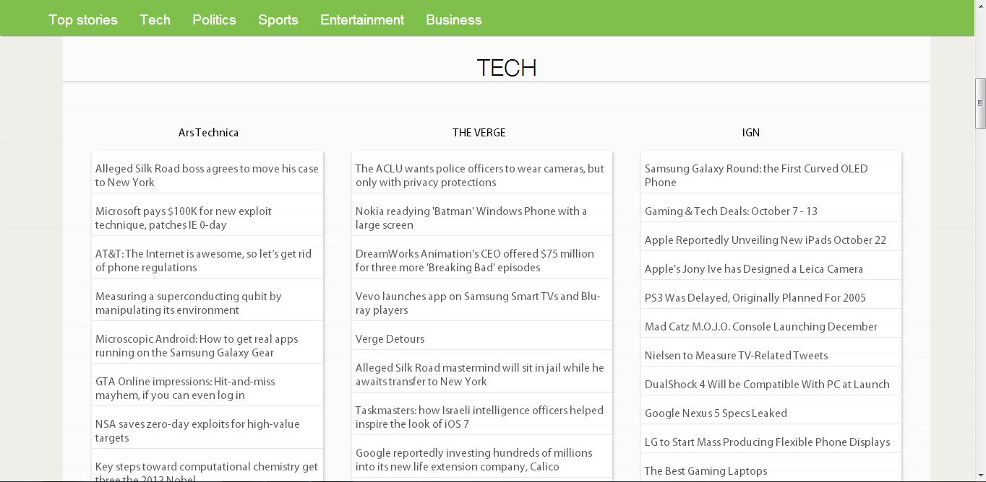

Slide 9
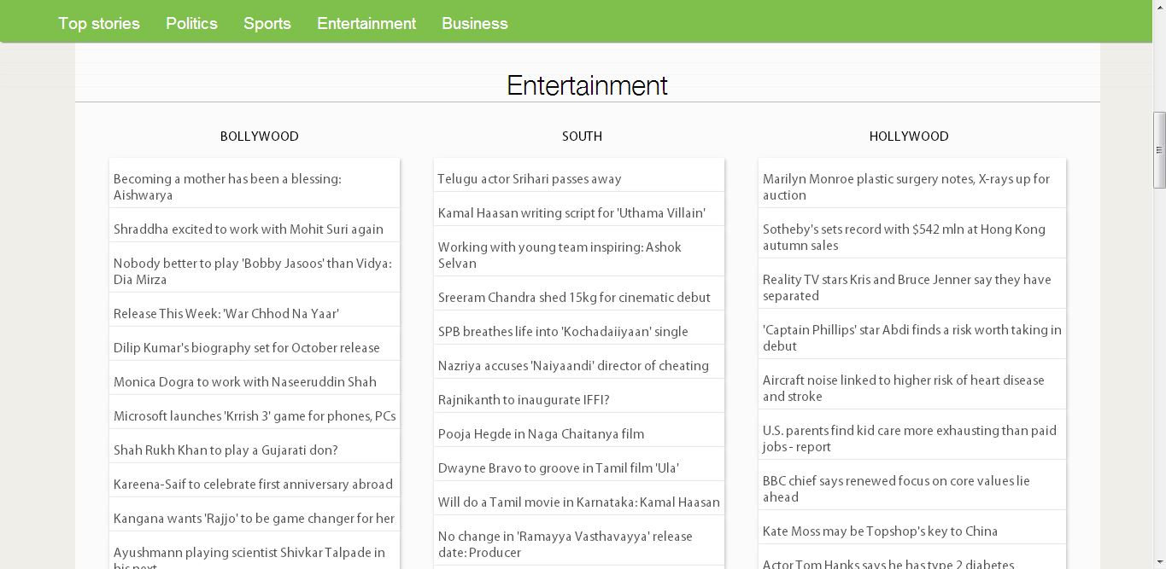

Slide 10
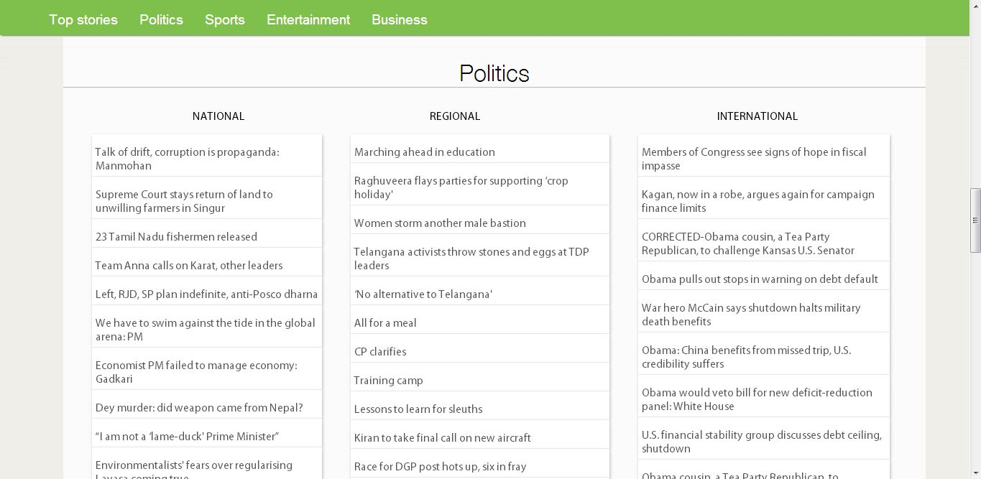

Slide 11
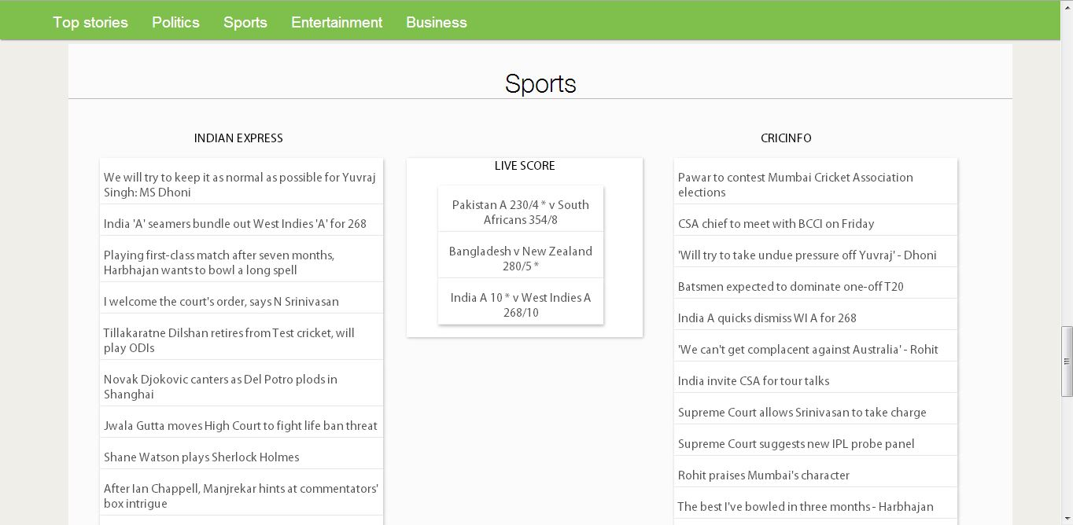

Slide 12
